Slide 1
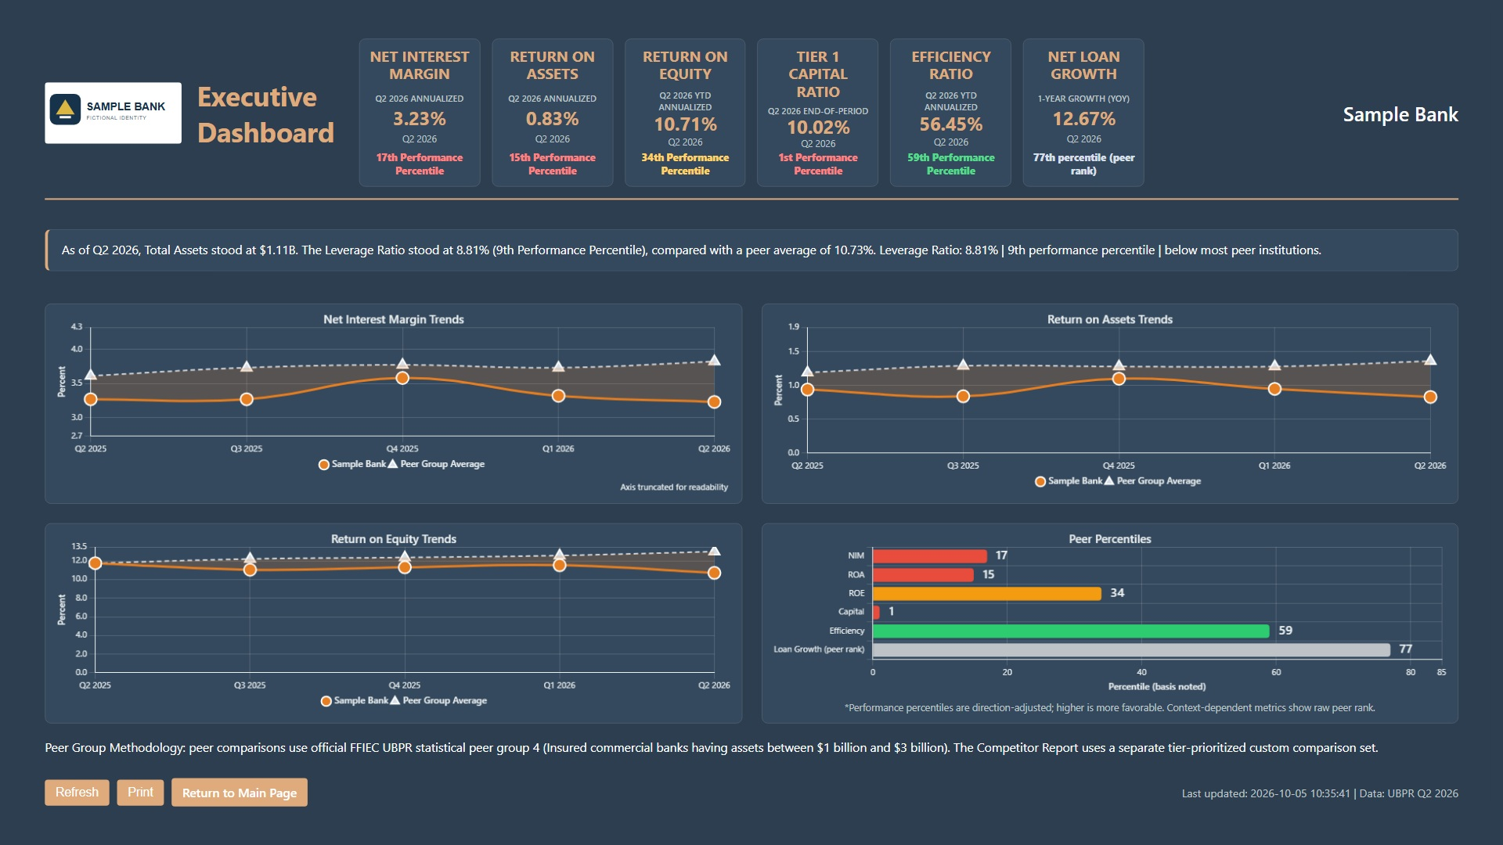
Notes:
Executive Dashboard. Sample materials use fictional institution names and branding. Financial figures and reporting periods are retained from public UBPR data for the periods shown. Fiduciary Services is a separate Q4 2025 institution example; the other dashboards use Q2 2026 data. This slide contains a dashboard image; individual charts and text are not editable. Source: corresponding interactive dashboard in this sample package.

Slide 2
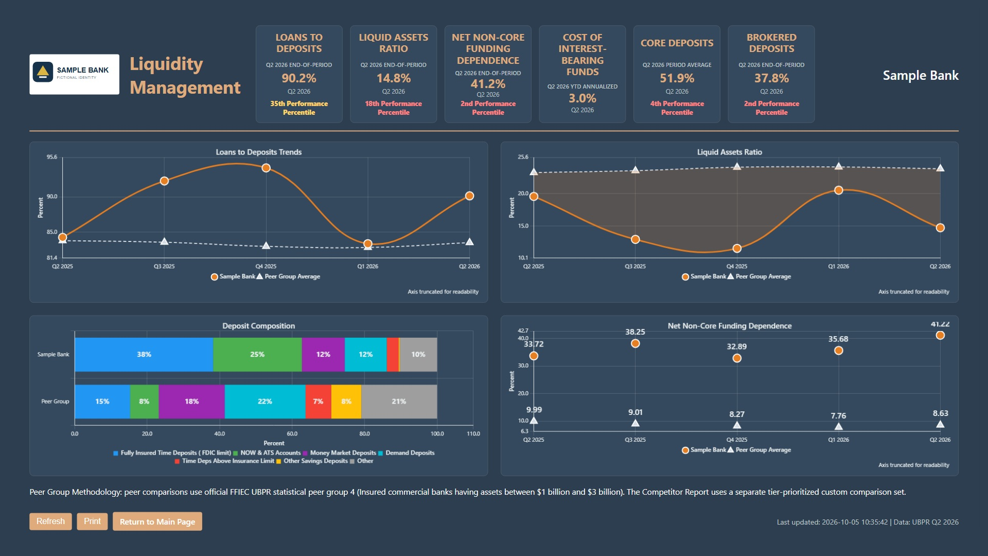
Notes:
Liquidity Management. Sample materials use fictional institution names and branding. Financial figures and reporting periods are retained from public UBPR data for the periods shown. Fiduciary Services is a separate Q4 2025 institution example; the other dashboards use Q2 2026 data. This slide contains a dashboard image; individual charts and text are not editable. Source: corresponding interactive dashboard in this sample package.

Slide 3
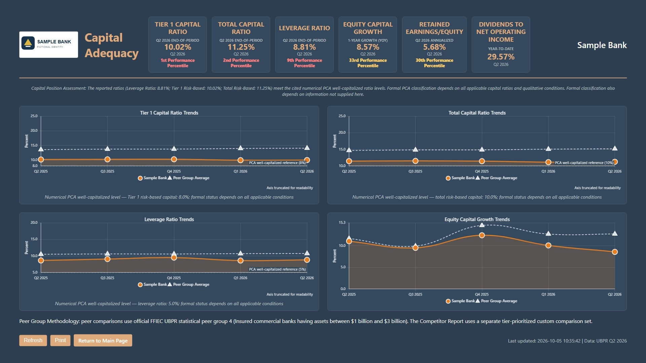
Notes:
Capital Adequacy. Sample materials use fictional institution names and branding. Financial figures and reporting periods are retained from public UBPR data for the periods shown. Fiduciary Services is a separate Q4 2025 institution example; the other dashboards use Q2 2026 data. This slide contains a dashboard image; individual charts and text are not editable. Source: corresponding interactive dashboard in this sample package.

Slide 4
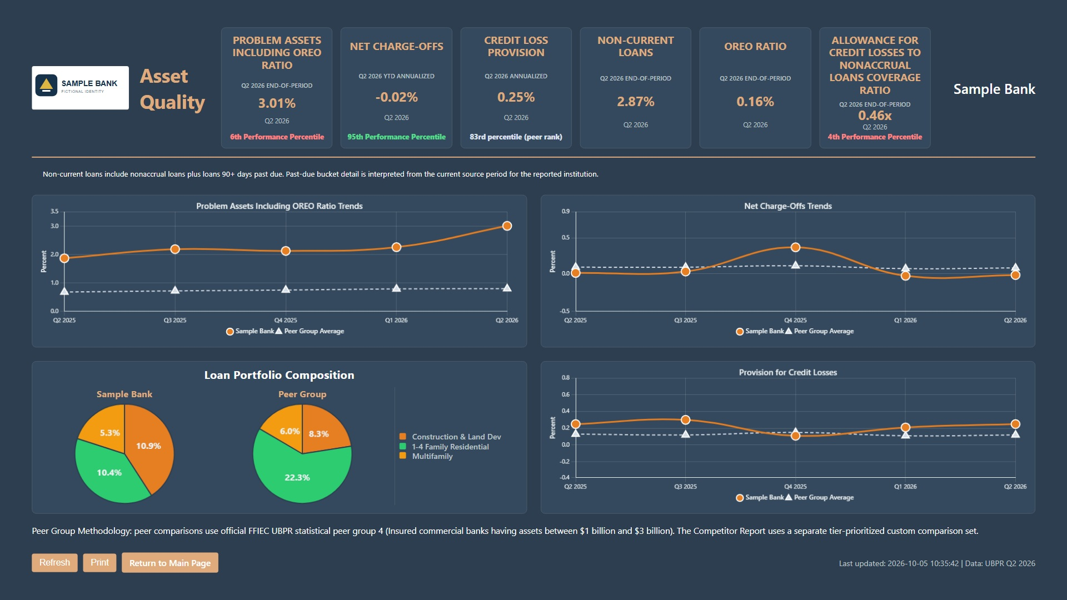
Notes:
Asset Quality. Sample materials use fictional institution names and branding. Financial figures and reporting periods are retained from public UBPR data for the periods shown. Fiduciary Services is a separate Q4 2025 institution example; the other dashboards use Q2 2026 data. This slide contains a dashboard image; individual charts and text are not editable. Source: corresponding interactive dashboard in this sample package.

Slide 5
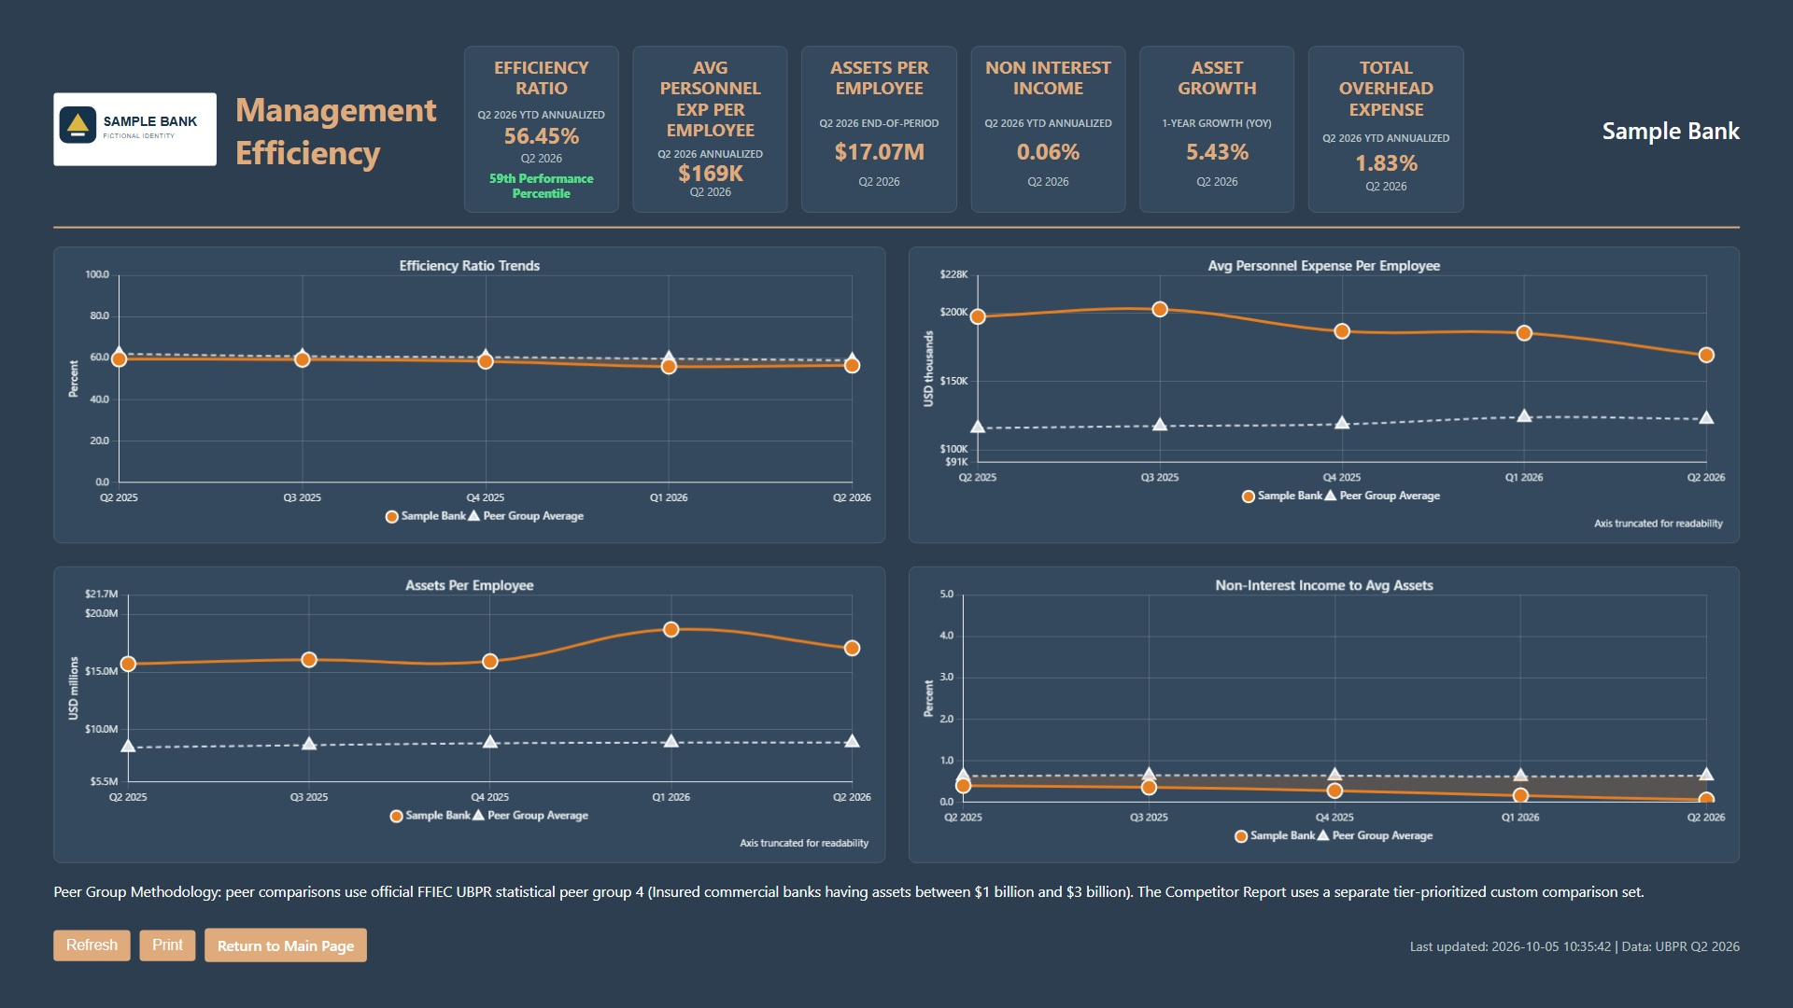
Notes:
Management Efficiency. Sample materials use fictional institution names and branding. Financial figures and reporting periods are retained from public UBPR data for the periods shown. Fiduciary Services is a separate Q4 2025 institution example; the other dashboards use Q2 2026 data. This slide contains a dashboard image; individual charts and text are not editable. Source: corresponding interactive dashboard in this sample package.

Slide 6
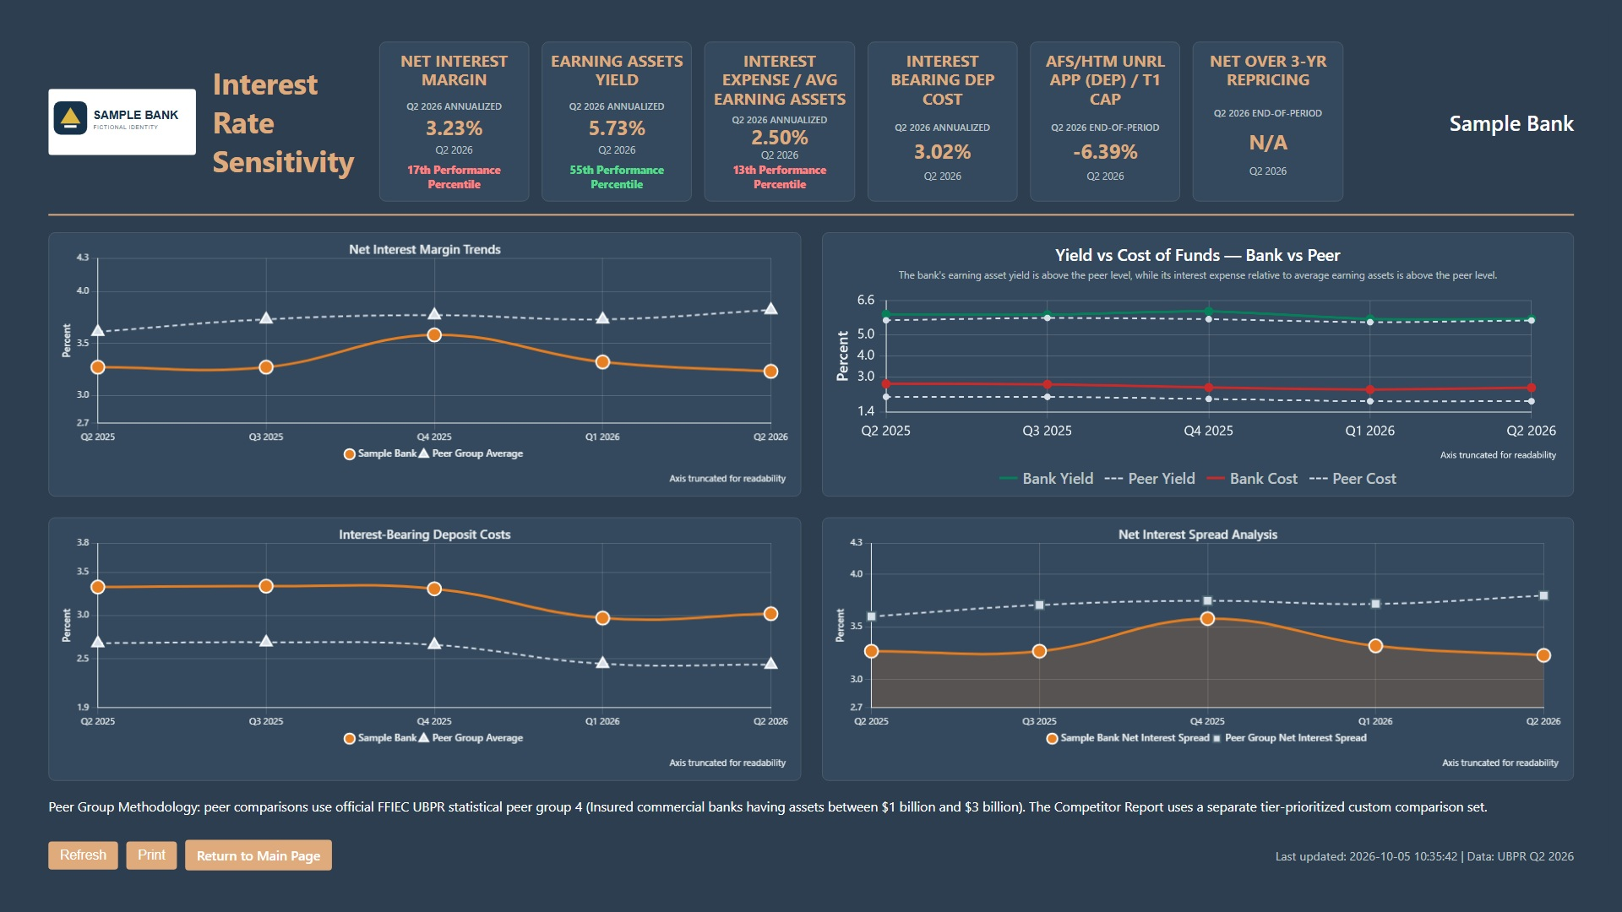
Notes:
Interest Rate Sensitivity. Sample materials use fictional institution names and branding. Financial figures and reporting periods are retained from public UBPR data for the periods shown. Fiduciary Services is a separate Q4 2025 institution example; the other dashboards use Q2 2026 data. This slide contains a dashboard image; individual charts and text are not editable. Source: corresponding interactive dashboard in this sample package.

Slide 7
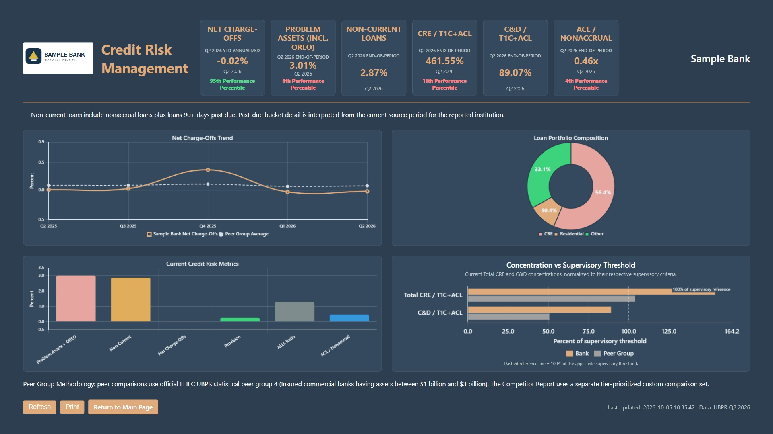
Notes:
Credit Risk Management. Sample materials use fictional institution names and branding. Financial figures and reporting periods are retained from public UBPR data for the periods shown. Fiduciary Services is a separate Q4 2025 institution example; the other dashboards use Q2 2026 data. This slide contains a dashboard image; individual charts and text are not editable. Source: corresponding interactive dashboard in this sample package.

Slide 8
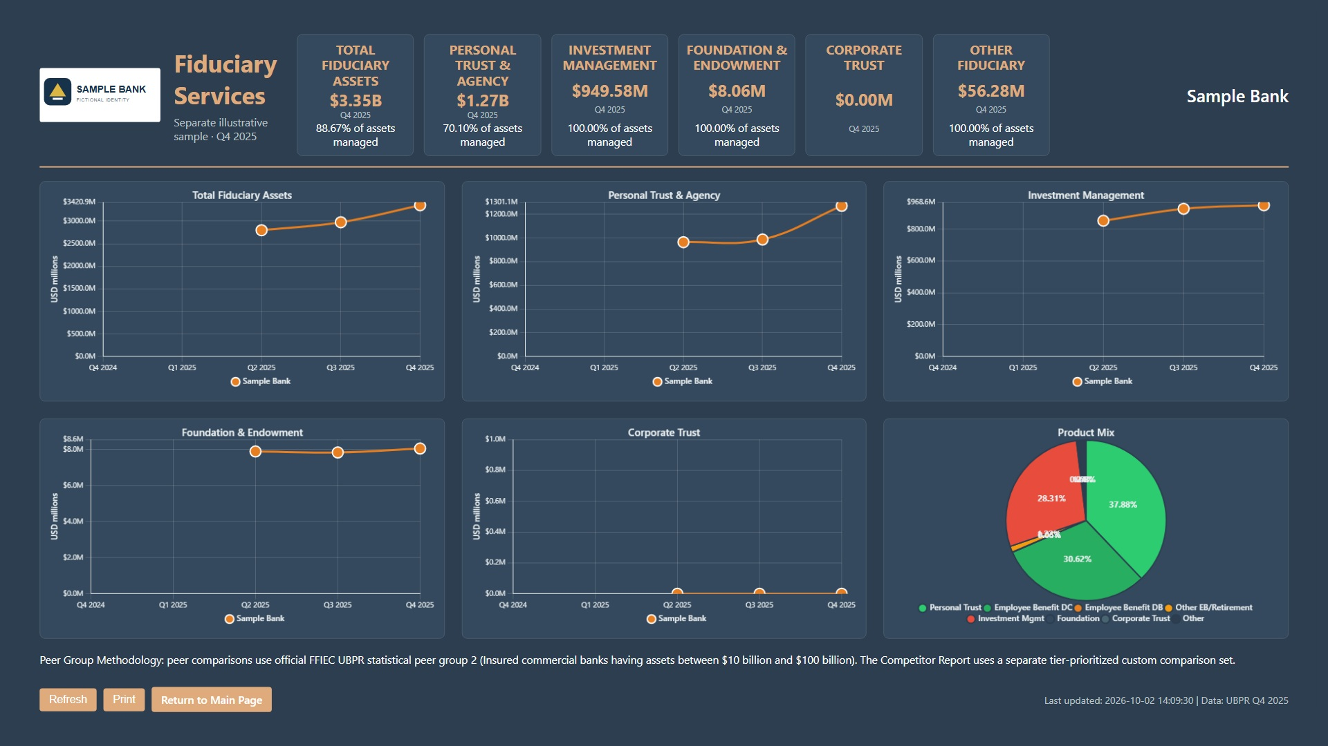
Notes:
Fiduciary Services. Sample materials use fictional institution names and branding. Financial figures and reporting periods are retained from public UBPR data for the periods shown. Fiduciary Services is a separate Q4 2025 institution example; the other dashboards use Q2 2026 data. This slide contains a dashboard image; individual charts and text are not editable. Source: corresponding interactive dashboard in this sample package.

Slide 9
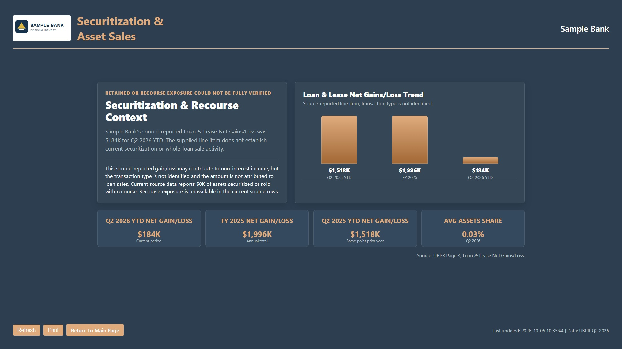
Notes:
Securitization & Asset Sales. Sample materials use fictional institution names and branding. Financial figures and reporting periods are retained from public UBPR data for the periods shown. Fiduciary Services is a separate Q4 2025 institution example; the other dashboards use Q2 2026 data. This slide contains a dashboard image; individual charts and text are not editable. Source: corresponding interactive dashboard in this sample package.

Slide 10
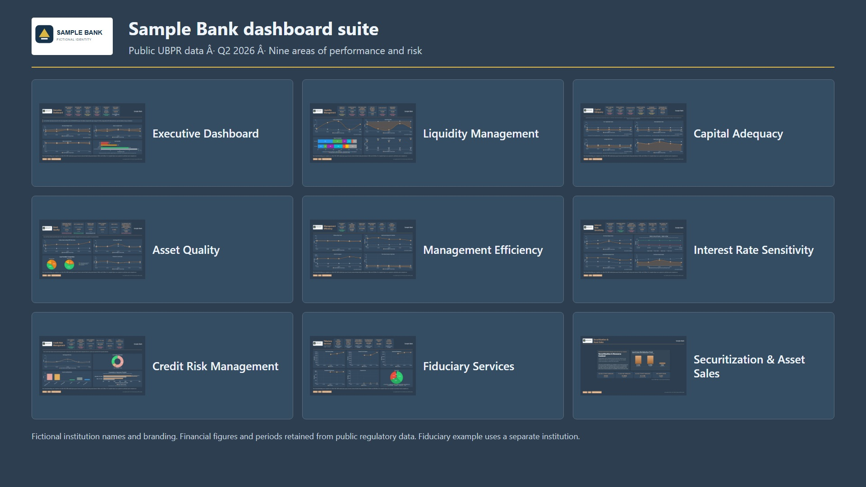
Notes:
Dashboard Suite Overview. Sample materials use fictional institution names and branding. Financial figures and reporting periods are retained from public UBPR data for the periods shown. Fiduciary Services is a separate Q4 2025 institution example; the other dashboards use Q2 2026 data. This slide contains a dashboard image; individual charts and text are not editable. Source: corresponding interactive dashboard in this sample package.

